Slide 1

News Articles Classifier
Capstone project
Uday & chandan

Slide 2



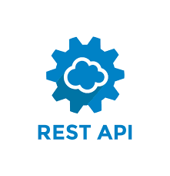















Project Overview – Executive Summary
Objective
Dataset
Design complete solution to demonstrate end-to-end pipeline development and manage a machine/deep learning project
Develop an understanding of all stages of a machine learning project life-cycle
Demonstrate understanding of challenges encountered during the project development and provide ways to tackle them
Showcase understanding of software engineering best practices while developing the project
Link to API: https://rapidapi.com/newscatcher-api-newscatcher-api-default/api/free-news/
RSS Feed using Feed Parser
Tools required
Problem Statement
Classify News Articles into categories - With information overload today users are inundated with news articles of all topics, even the ones which may not be relevant to users. Design a system which can classify incoming news articles and appropriately tag the corresponding category. Develop a data pipeline which includes the all the following stages of Machine Learning Project Life Cycle –
1.Data Ingestion
2.Data Preparation
3.Data segregation & Model Training
4.Model Deployment
5.Model Prediction
Project Milestones
Data Ingestion
Data Segregation & Model Training
Data Cleansing & Preparation
Model Deployment
Project Team
Mentor: Vaibhav
Team Members: Uday & Chandan
Model Prediction

Slide 3






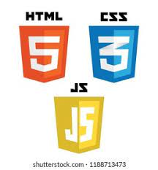


Project Plan
Web Framework for Python which provides functionality for building web applications including managing HTTP requests and rendering templates
Distributed processing system used for data workloads
Application used for API Testing. Its an HTTP client that tests HTTP requests, utilizing a graphical user interface, through which we obtain different types of responses that need to be subsequently validated
Real-time streaming data pipelines adapting to data streams
Data Pipelines
Project Plan & Architecture
Data storage using RDBMS/No RDBMS methods
Data Cleansing
Project Problem Statement
Model Prediction
Data Ingestion
Model Training
Package Application into containers – standardized executable components combining application source code with the operating system libraries and dependencies required to run that code in any environment
Building webpages. HTML provides the structure of the pages, CSS the layout
Framework that supports the machine learning lifecycle. This means that it has components to mirror the model during training & running, ability to store models load the model in production code and create a pipeline

Slide 4

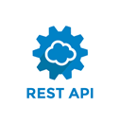



Solution Architecture
Kafka Connect
News websites/Service Providers
Rest Proxy
News Articles
Kafka Producer
Schema Registry
Training
Python Kafka Producer
Feature Data Input
Feature Data Input
Kafka Broker
ML Model
Model Params
Kafka Consumer
Kafka Streams
Output
Training Data
Model Prediction
Production ML App
Model Building
Model Deployment
Results

Slide 5
Data Ingestion
Project Name - data-ingestion-service: The objective of this project is to source new data to re-train the model. This project should connect to at least 2 different news sources. Ingestion could be done either as follows:
Via REST APIs (search news APIs available on rapidAPI, for example https://rapidapi.com/newscatcher-api-newscatcher-api-default/api/free-news/
Via RSS feed (For instance by using BeautifulSoup to scrap RSS feed)
Create your own mock news generator service
Ensure that the collected news has “category” or “topic” as a part of raw data irrespective of the source. Data Cleaning - Since different news sources could have different response formats, transform the API response for all news sources to same raw format, which should include following fields –
Title
date/ time
Summary
topic/ category
Source
Scheduling - Schedule all news source services to collect news using a process scheduler (every few mins/ hours), or with custom thread management code. Data Storage – Use a Publisher – Subscriber model to collect data and push it to the store. Create a Kafka topic and use it to queue cleaned responses from all sources. The sink for the stream should be MySQL/ MongoDB.

Slide 6
Data Cleansing & Preparation
Project Name - model-training-service: The objective of this project is to trigger model re-training and deployment on-demand. Over a period, the performance of models degrades, and it becomes important to retrain them. Before using the raw data can be used for model training/ retraining it needs to be preprocessed to relevant structure.
Load the data from “raw data” source (MySQL/ MongoDB) into Spark by using relevant connector for PySpark.
Perform data cleaning and preprocessing, followed by segregation to train and test datasets. (Necessary pre-training steps to be shared with participants)
Perform model re-training (a pre-trained model along with code to retrain the model could be provided to participants).
Highlight the explainability of the AIML model by white boxing which patterns learnt by the training data arrives to a particular class [ News topic ].
Serialize the model and save it to a location (or push the model to a model registry like MLFlow), which can later be used for model retrieval model deployment
Workflow Steps
Fetch raw data from APIs
Store data in MongoDB
Fetch data from MongoDB to Data frame
Pre-Processing of data of the retrieved from MongoDB
Splitting of Training data and Testing Data
Model Building
Data should have 2 parameters – News Description& Title
Data Label/Data Category (Business, Sports, Entertainment, Media)
Text Extraction & Stop-words Removal

Slide 7
Model Prediction
Project Name - model-prediction-service: A separate classifier project picks up the trained model either from a location or from the model registry, and exposes it for prediction in following modes -
Real Time REST (flask) API – allows users to initiate a classification request in JSON or any other format using a REST client and returns the classified category in real time. This API should be a POST request and should accept JSON in request and return JSON as response. Request body should contain 2 fields - the title and description/summary of a single news article. Response should contain the predicted category as a field
Batch Mode (IF TIME PERMITS) – Allow user to pass bulk news articles, and project returns a bulk classification response. It could also be an API which accepts multipart requests containing excel in a predetermined format, and simply submits the request to the bulk process. Response would be a unique id. Another API retrieves the processed excel with classified responses, once the processing is complete, or returns “WIP” if the processing is still in progress.
User Interface - A simple Stream-lit app or a basic HTML page containing a form can be exposed in this project.
It takes the title and the description/ summary of the article, calls the flask API for prediction, and shows the predicted classification.
It provides an option to upload a batch file and response can be processed and stored at a folder location.

Slide 8
Model Infrastructure & Deployment
Docker images may be created for all the 3 projects. These images can then be used for deployment as containers.
Deployment can be orchestrated by using docker-compose (optional)
Flask APIs (wherever required) should use Gunicorn/ Bjoern/ CherryPy as a WSGI server.
Use PEP guidelines for python code standards
ML Tools:
Following tools to be used for project setup –
PyCharm as Python IDE
Virtual Environment – use venv or virtualenvwrapper to setup separate environments for all projects described.
MySQL/ MongoDB as datastore.
PySpark for stream processing.
POSTMAN for testing Flask APIs.
Apache Zookeeper + Kafka for message queue/ streams.
Tensorboard for monitoring the progress of model retraining.
MLFlow for model versioning + hyper-parameters versioning.
Python cookiecutter templates may be used for setting up the project

Slide 9
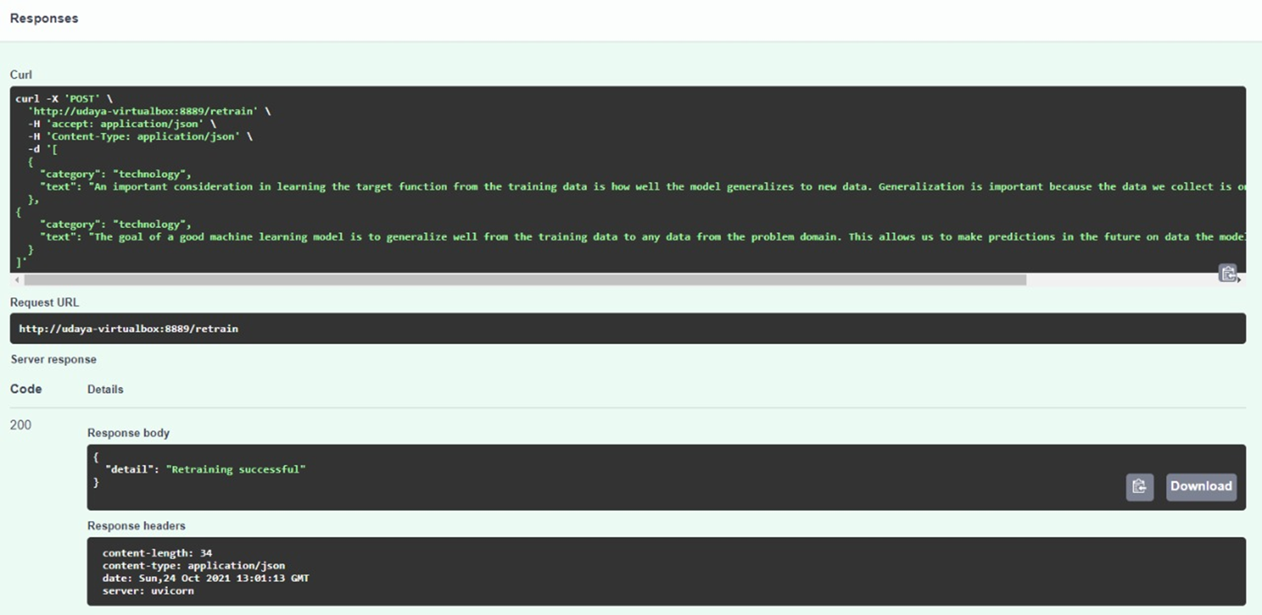
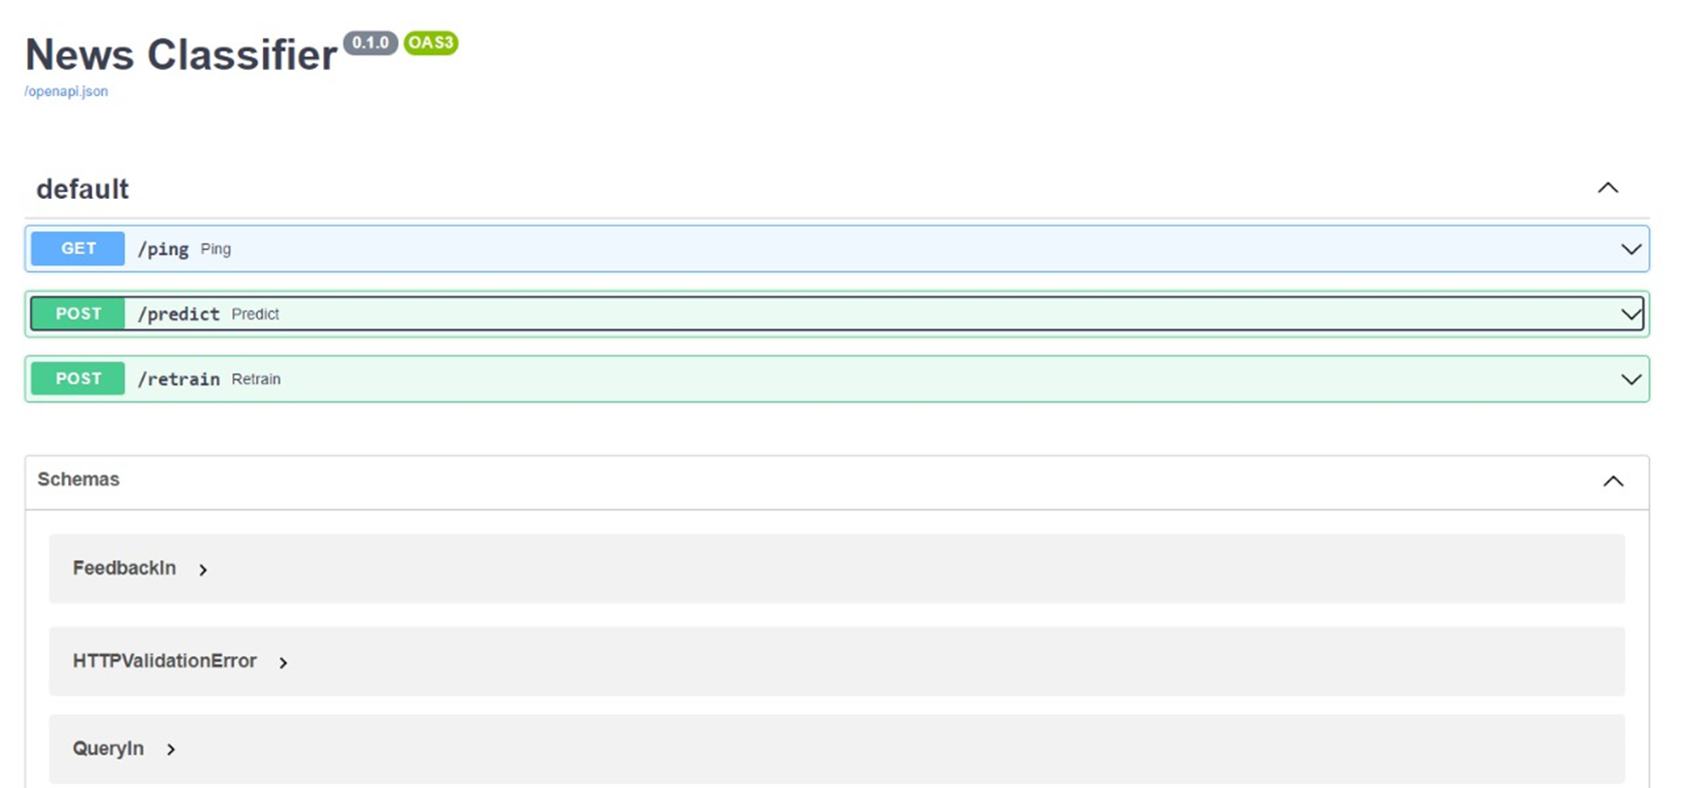
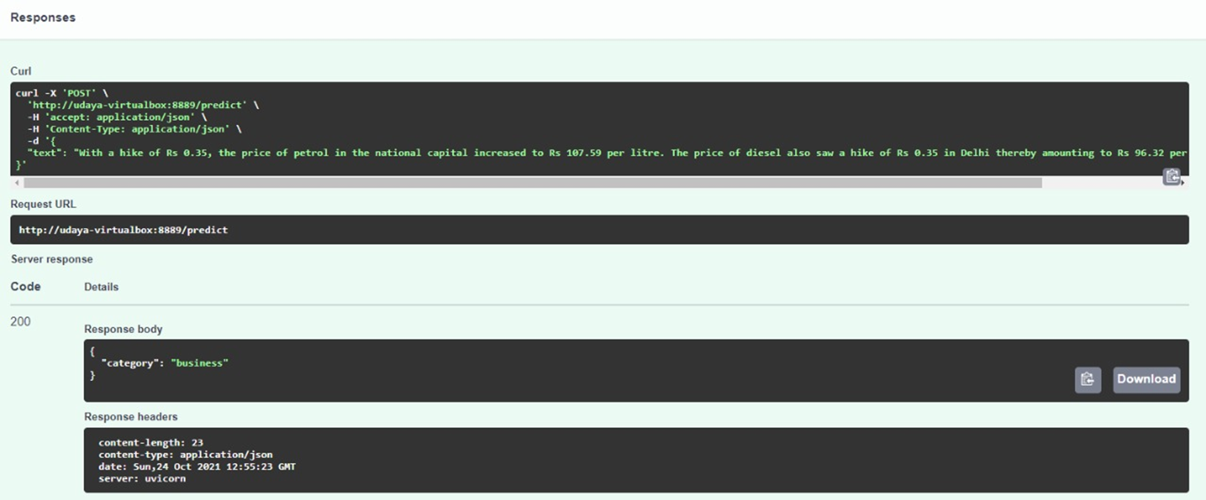
Model Solution & Output

Slide 10
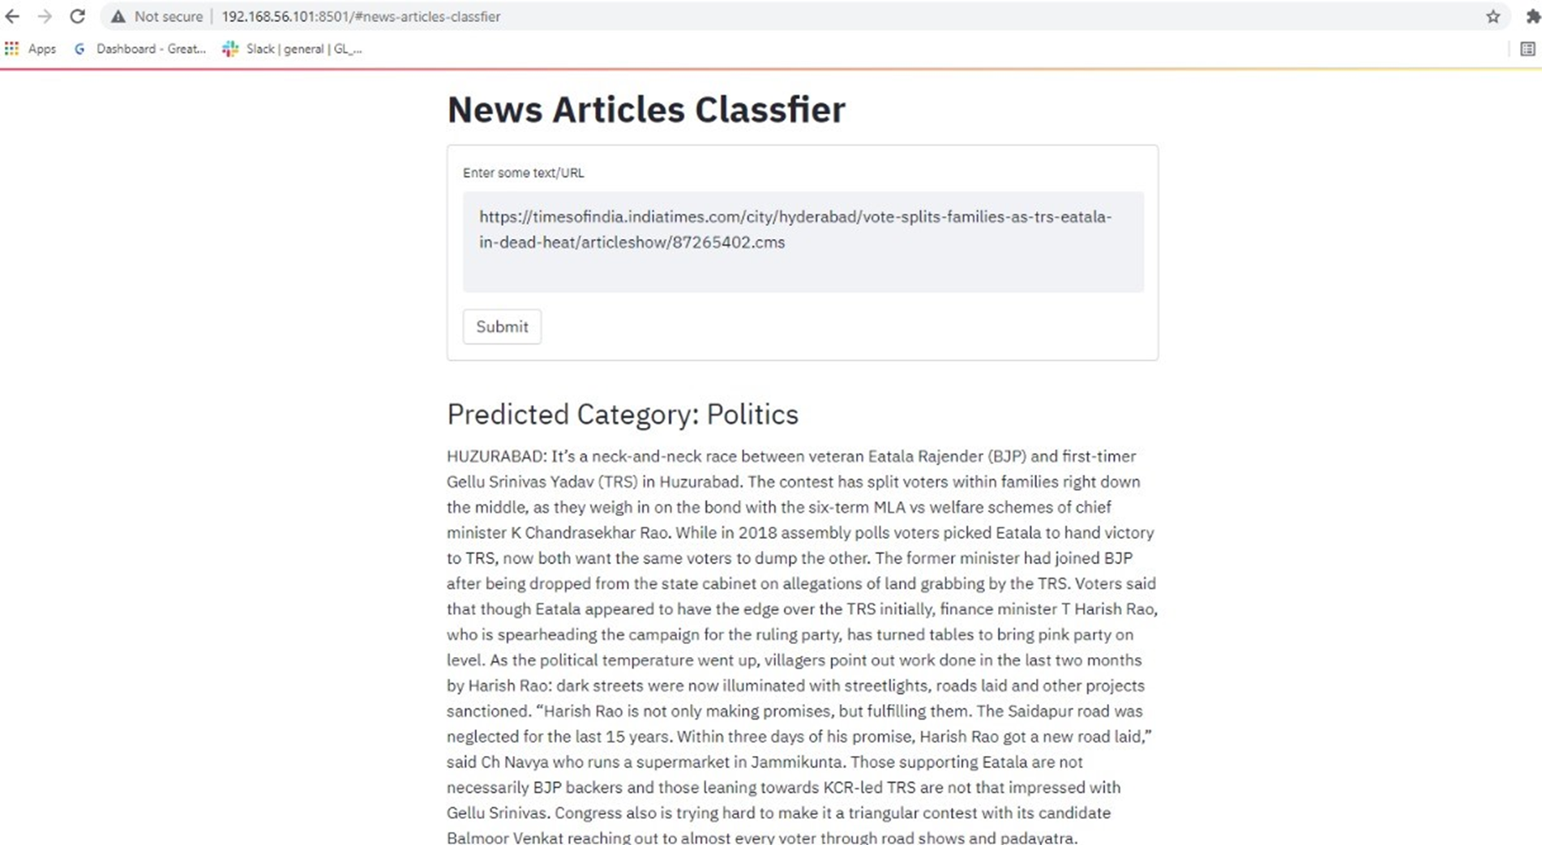
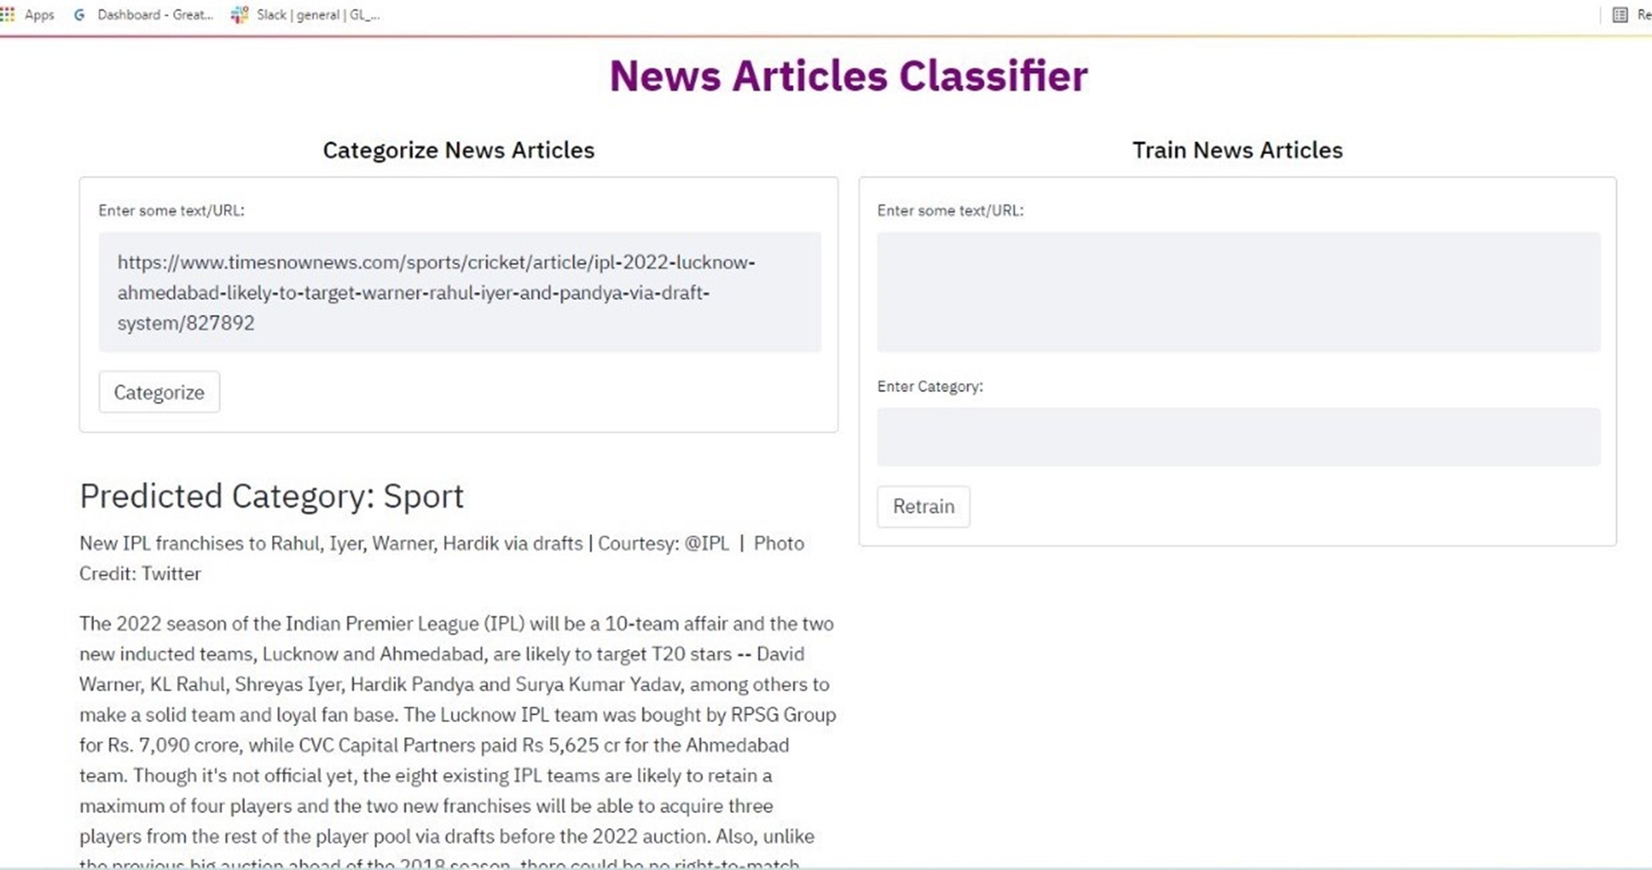
Model Solution & Output

Slide 11

Thank You

